Slide 1
introduction
R From scratch: an intro to data analytics
Jasser Jasser

Slide 2
Agenda
Introduction
Learning Objectives
Important Questions
Setting Up Your Environment
The burden of the programmer
Few last words
Notes:
Agenda * Introduction * Learning Objectives * Important Questions * What is a programming language? * What is the R language? * Why R and not Python? * What is data analytics? * What are the tools of the trade? * Why it matters? * I am sold. Where to Start? * Setting Up Your Environment * Installing R * Installing RStudio * Getting to Know the RStudio Interface * Installing Packages * Writing Your First R Script * The burden of the programmer * Few last words

Slide 3
Introduction
Comprehensive guide to mastering R programming language
Smooth learning curve and deep understanding of fundamentals
R is designed for statistical computing and graphics
Widely used for statistical software development and data analysis
Open-source project with a vibrant community
Rich ecosystem of packages and resources
First half of book covers programming concepts
Gradually builds up to more complex topics
Second half explores data analysis
Covers data cleaning, advanced manipulation, and statistical analysis
Notes:
Welcome to R from Scratch, your guide to mastering the R programming language. This book is designed to guide beginners through the world of R programming, providing a smooth learning curve and deep understanding of the fundamentals. R is an open-source language designed for statistical computing and graphics, with a rich ecosystem of packages and resources. The first half of the book covers programming concepts, while the second half explores data analysis. Our goal is to empower you to use R confidently and effectively.

Slide 4
Learning Objectives
Understand the Advantages of R for Data Analysis
Recognize why R is a preferred tool for data analysis and statistical modeling
Learn about its ecosystem of packages and compatibility with report-generation tools for reproducible research
Define Data Analytics and its Importance
Describe the role of a data analyst and the significance of data analytics in uncovering insights from large datasets
Learn how data analytics informs decision-making in various sectors
Identify Essential Tools for Data Analysis
Become familiar with the RStudio Integrated Development Environment (IDE)
Appreciate the Impact of Data Analytics
Set Up the R Programming Environment
Install R and RStudio
Navigate the RStudio Interface
Notes:
In this chapter, we will learn about the advantages of using R for data analysis, the importance of data analytics, essential tools for data analysis, the impact of data analytics, how to set up the R programming environment, and how to navigate the RStudio interface.

Slide 5
What is a programming language?
Programming languages are used to communicate with machines
Structured set of syntax and semantics
Allows humans to express instructions for computers to execute
There are many different programming languages
Each with distinct characteristics and functionalities
Some are tailored for specific tasks, while others are general-purpose
This book focuses on the R language for data analysis
Covers basics of data manipulation to advanced statistical techniques
Includes best practices for data cleaning and preprocessing
Provides hands-on experience with real-world datasets
Notes:
In this slide, we introduce the concept of programming languages, which are used to communicate with machines. There are many different languages, each with their own characteristics and uses. This book focuses on the R language, which is used for data analysis. We will cover everything from the basics to advanced techniques, and provide hands-on experience with real-world datasets.

Slide 6
What is the R language?
Programming language for statistical analysis and data visualization
Widely used by statisticians, data scientists, and researchers
Provides a wide variety of statistical and graphical techniques
Linear and nonlinear modeling, classical statistical tests, time-series analysis, classification, clustering, and others
Highly extensible and supports multiple programming paradigms
Object-oriented, imperative, and functional programming
Notes:
R language is a programming language made for statistical analysis and data visualization. It is widely used by statisticians, data scientists, and researchers. R provides a wide variety of statistical and graphical techniques and is highly extensible, supporting multiple programming paradigms.

Slide 7
Why R and not Python?
Python is a versatile and general-purpose language
Applicable to a wide range of tasks
R is developed by statisticians and excels in handling complex statistical operations
Offers an extensive array of statistical tests and models
R provides a unique and advanced experience for data visualization
Libraries such as ggplot2 and shiny enable the creation of sophisticated and flexible plots
R's syntax is designed to be intuitive and user-friendly for data analysis and statistical work
Rich ecosystem of packages tailored for data analysis
R's compatibility with report-generation tools positions it as an excellent resource for reproducible research
Users can integrate code, outputs, and narrative into a cohesive document
Notes:
In this slide, we discuss the question of whether to learn R or Python for data analysis. While Python is a versatile and general-purpose language, R, developed by statisticians, excels in handling complex statistical operations and provides a unique and advanced experience for data visualization. R's syntax is designed to be intuitive and user-friendly for data analysis and statistical work, and its compatibility with report-generation tools positions it as an excellent resource for reproducible research.

Slide 8

Important Questions: What is data analytics?
Explore vast amounts of data to provide insights
Answer specific questions, from fun to serious
Uncover patterns, trends, and insights
Use tools to uncover hidden information
Notes:
As a data analyst, you'll explore vast amounts of data to provide insights and answer specific questions. Using tools, you'll uncover patterns, trends, and insights that are not immediately obvious. Your job is to investigate and find answers.

Slide 9
Important Questions: What are the tools of the trade?
RStudio is an IDE for R programming
Provides a user-friendly interface and tools to enhance coding experience
Streamlines the process of writing, debugging, and executing R code
Offers features such as syntax highlighting, code completion, and integrated documentation
Provides tools for managing and visualizing data
Allows for creation of interactive visualizations and generation of reports
A versatile tool for efficient and effective R programming
Notes:
RStudio is an IDE that makes it easier to write and run R code. It offers features such as syntax highlighting, code completion, and integrated documentation. RStudio also provides tools for managing and visualizing data, creating interactive visualizations, and generating reports. It is a powerful and versatile tool for R programming.

Slide 10
Important Questions: Why it matters?
Data Analytics for Informed Decisions
Enables organizations to identify opportunities and solve complex problems
Used in a wide range of industries, including finance, healthcare, marketing, and technology
Skills Required for Data Analysts
Proficiency in programming languages like R and Python
Familiarity with tools like RStudio and Jupyter Notebook
Knowledge of statistical techniques, data visualization, and machine learning
Notes:
Data analytics is a critical component of modern business and research. It enables organizations to make informed decisions, identify opportunities, and solve complex problems. As a data analyst, you will need to be proficient in programming languages like R and Python, as well as tools like RStudio and Jupyter Notebook. You will also need to be familiar with statistical techniques, data visualization, and machine learning.

Slide 11
I am sold. Where to Start?
Setting Up Your Environment
Install R and RStudio for a user-friendly coding experience
Familiarize Yourself with the Basics
Understand the structure of R scripts and how to execute code
Practice, Practice, Practice
Make use of exercises and examples to improve your skills
Make Use of Resources
Supplement your learning with online tutorials, forums, books, and courses
Learn by Doing
Apply your knowledge to real-world data for invaluable experience
Take It One Step at a Time
Don't rush through the topics and celebrate your progress
Notes:
Embark on the journey of learning R with these initial steps and resources. Set up your environment with R and RStudio, familiarize yourself with the basics, and practice regularly. Make use of resources and learn by doing with real-world data. Take it one step at a time and celebrate your progress.

Slide 12
Setting Up Your Environment: Installing R
Windows
Visit the CRAN website and choose a geographically close mirror
Click on 'Download R for Windows' then 'base'
Download and run the latest version of R, following the instructions
Mac
Visit the CRAN website and choose a geographically close mirror
Click on 'Download R for (Mac) OS X'
Download and open the latest version of R, following the instructions
Linux
Installation process depends on distribution
Visit the CRAN website and navigate to the section for your distribution
Notes:
R is available for Windows, Mac, and Linux. You can download it from the Comprehensive R Archive Network (CRAN). The installation process is different for each operating system. For Windows and Mac, visit the CRAN website, choose a geographically close mirror, and follow the instructions. For Linux, the installation process depends on your distribution. Visit the CRAN website for detailed instructions.

Slide 13
Setting Up Your Environment: Installing RStudio
Integrated Environment
Provides an all-in-one interface for writing scripts, viewing output, visualizing data, and managing packages
User-Friendly Interface
Clean and well-organized layout makes it easier for beginners to find and use the features they need
Helpful Tools and Shortcuts
Includes a variety of tools and shortcuts that simplify coding in R
Extensive Community and Resources
Large and active community with a wealth of tutorials, forums, and resources available
Designed Specifically for R
Tools and features are tailored to the needs of R users
Notes:
RStudio is an excellent choice for those new to R. It provides an integrated environment, user-friendly interface, helpful tools and shortcuts, extensive community and resources, and is designed specifically for R. These features make it the recommended interface for working through the examples and exercises in this book.

Slide 14
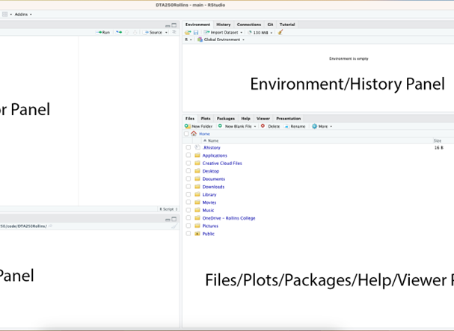
Setting Up Your Environment: Getting to Know the RStudio Interface
Script Panel
Top left panel for writing and editing R scripts
Console Panel
Bottom left panel where R code is executed and results are displayed
Environment/History Panel
Top right panel displaying datasets, variables, and command history
Files/Plots/Packages/Help/Viewer Panel
Bottom right panel for managing files, viewing plots, and accessing help
Additional Features
Autocomplete, syntax highlighting, debugging tools, and version control integration
Notes:
In this section, we'll be discussing the RStudio interface, which is divided into four main panels. The Script panel, Console panel, Environment/History panel, and the Files/Plots/Packages/Help/Viewer panel. Additionally, RStudio offers features such as autocomplete, syntax highlighting, debugging tools, and version control integration to enhance your coding experience.

Slide 15
Setting Up Your Environment: Installing Packages
Open-source programming language
Users can contribute and share code
Contributions often come in the form of packages
Tidyverse package
Collection of R packages designed for data science
Includes packages for data manipulation, visualization, and import
Installing and loading tidyverse
Use install.packages() and library() functions
Managing packages
Update packages with update.packages() function
View installed packages with installed.packages() function
Load multiple packages at once with library() function
Notes:
R is an open-source programming language where users can contribute and share code in the form of packages. The tidyverse package is a collection of R packages designed for data science. It can be installed and loaded using the install.packages() and library() functions. Packages can be managed by updating, viewing installed packages, and loading multiple packages at once.

Slide 16
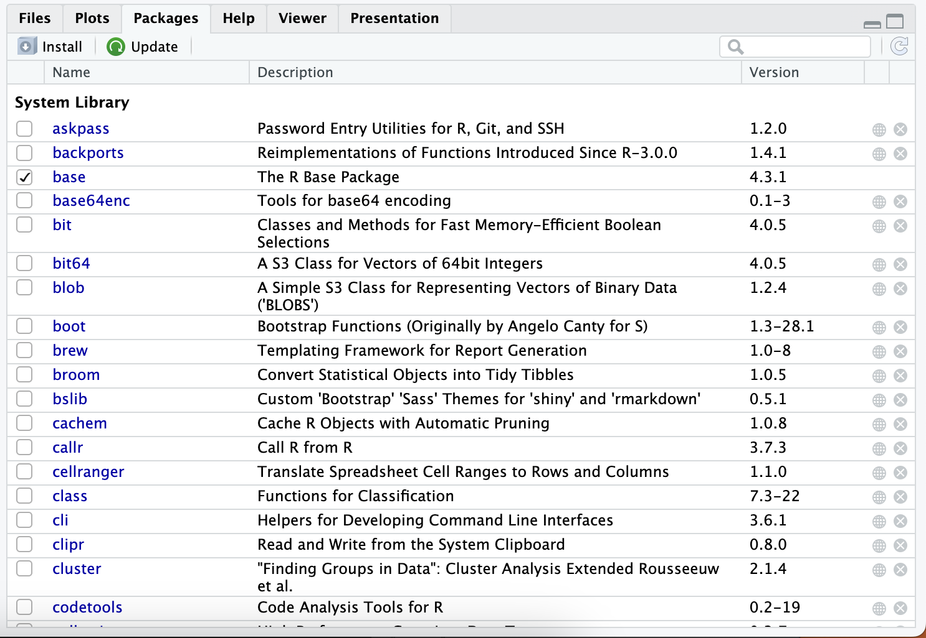
Setting Up Your Environment: Installing Packages
Manage R packages installed on your device
Install, remove, or update packages
Check box next to each package
Indicates if package is loaded into environment
User-friendly interface
View, load, update, and uninstall packages
Notes:
The Packages tab in RStudio allows you to manage the R packages installed on your device. You can install, remove, or update packages, and a check box next to each package indicates if it is loaded into your environment. The interface is user-friendly, allowing you to view, load, update, and uninstall packages with ease.

Slide 17
Setting Up Your Environment: Installing Packages
Viewing Installed Packages
Access the Packages tab in the lower right panel of RStudio
Displays a list of all the R packages that are currently installed on your system
Check or uncheck the box next to a package name to load or unload it
Loading Packages
Check the box next to the package name or type library(packagename) in the console or script editor
Installing New Packages
Click the “Install” button in the Packages tab or use the install.packages("packagename") function
RStudio will also install any dependencies
Updating Packages
Uninstalling Packages
Viewing Package Documentation
Notes:
In RStudio, you can manage your packages through the Packages tab. Here, you can view, load, install, update, uninstall, and access the documentation for your packages. Simply navigate to the Packages tab and use the provided buttons and checkboxes to perform the desired actions.

Slide 18
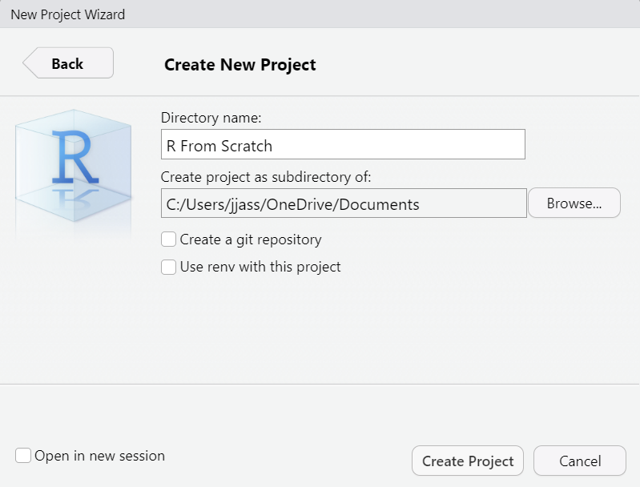
Setting Up Your Environment: Writing Your First R Script
Step 1: Create a new project
Go to File > New Project in RStudio
Select 'New Directory' then 'New Project'
Enter project name and directory location
Step 2: Open a New Script
Go to File > New File > R Script in RStudio
A new tab will open in the script editor
Step 3: Type Your Commands
Enter R commands in the script editor
Step 4: Save Your Script
Step 5: Run Your Script
Step 6: Review and Experiment
Notes:
In this section, we will guide you through writing your first R script. We will cover creating a new project, opening a new script, typing commands, saving your script, running your script, and reviewing and experimenting with the output. Follow these steps to get started with R programming.

Slide 19
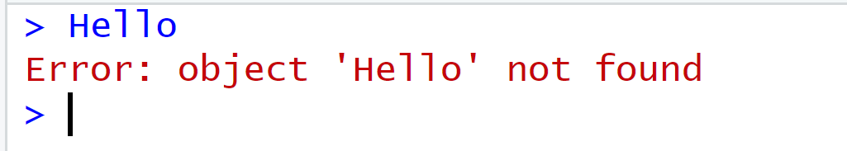
The burden of the programmer
Be careful with syntax
Use specific vocabulary understood by R Console
Errors can help trace and fix code
Example: Error message when using 'Hello' keyword
Communicating with R Console is like communicating with a cat
Both have limited vocabulary capacity
Specific phrases trigger specific reactions
Notes:
In order to communicate with the R Console, you need to use a specific vocabulary that it understands. Errors can help you trace and fix your code. It's like communicating with a cat, both have limited vocabulary capacity and specific phrases trigger specific reactions.

Slide 20

Few last words
First R script successfully written and run
Ready to dive into the world of R programming
Next chapters introduce basics of R
Plenty of opportunities for practice
Happy coding!
Notes:
Congratulations on writing and running your first R script! You're now ready to dive into the world of R programming. The next chapters will introduce you to the basics and provide plenty of opportunities for practice. Happy coding!

Slide 21

Final Thoughts
Practice, practice, practice…
AI is your friend IF you know how to ask.
In the end, depend on your own capabilities.

